Slide 1




SELF-PAY PREDICTION MODEL
Team Mavericks: Prajjwal Kumar, Siddharth JP, Vikas Khati

Slide 2

INDEX
Executive Summary
2) Loading and Reading the Data
Data analysis: Statistics and checking for Null Values
Correlation Heatmap
Feature Engineering
One-Hot, Label Encoding and Binary Encoding
Data Split and Training Model
Accuracy of the Model
Conclusion

Slide 3

Executive Summary
TVS Credit being a NBFC which is into lending, the monthly collections have a direct correlation to its profits.
Collections happen in mainly two methods, i) Field agents and ii) Telecall.
To reduce the human effort required in field we can use machine learning techniques to identify self paying customers
who can be targeted by the tele-callers.
The features are both categorical and numerical. The categorical variables, depending on the nature can be
converted to numerical using one hot encoding, binary encoding or label encoding.
Data pre-processing and feature engineering must be done to lower error rates and increase accuracy.
Models such as XG boost, logistic regression, Random forest are used to classify data and the accuracy rates
are compared. Highest of 94.5% is achieved.

Slide 4
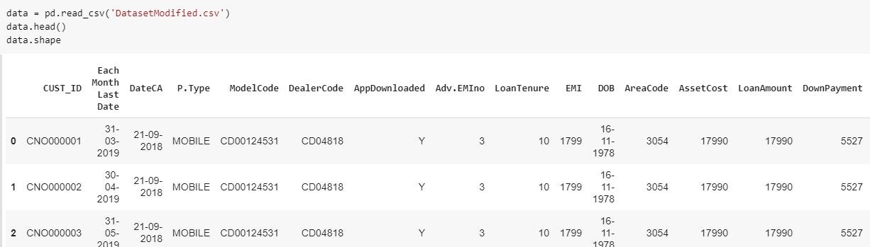
Loading and Reading the data
The dataset has 547308 data points and 30 columns consisting the features.
It has 29 features out of which 18 are numerical and 11 are categorical variables.
The last column being the target variable.
The shape() function gives the dimensions and the head() function describes the first 5 datapoints.

Slide 5
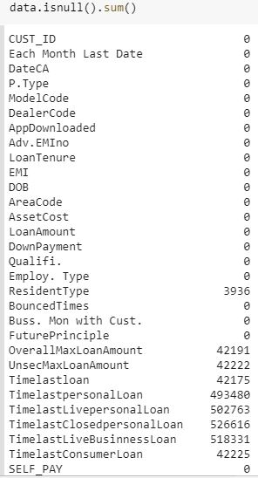
Data analysis: Checking for null values
While checking for null values we observe the following 3 occurrences.
Values missing in the range of ~500000
-Looking at the nature of the variables. There
can be 2 cases here, either the people might have not
taken the particular loan therefore we will put 0 or consider
them as missing values and drop the columns due to the size.
2. Values missing in the range of ~40000:
- We replace the values with the mean of the population.
Categorical variable missing values.
- Since the only one missing is Resident type , and the number of
missing values is less w.r.t to overall size , therefore we can assume
it as either owned or rent.

Slide 6
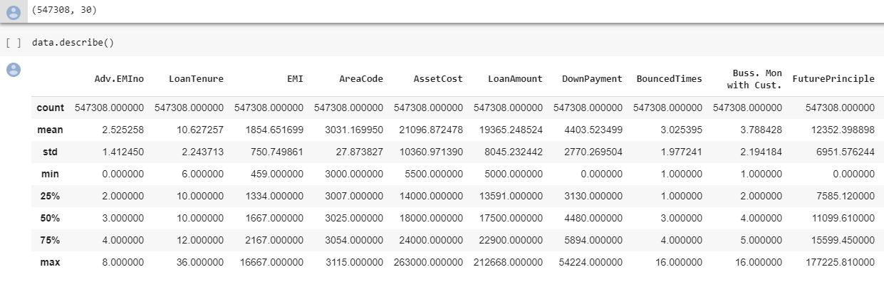
Data analysis: Statistics
We use the describe() function to learn about mean, std dev, min, max of the features.

Slide 7
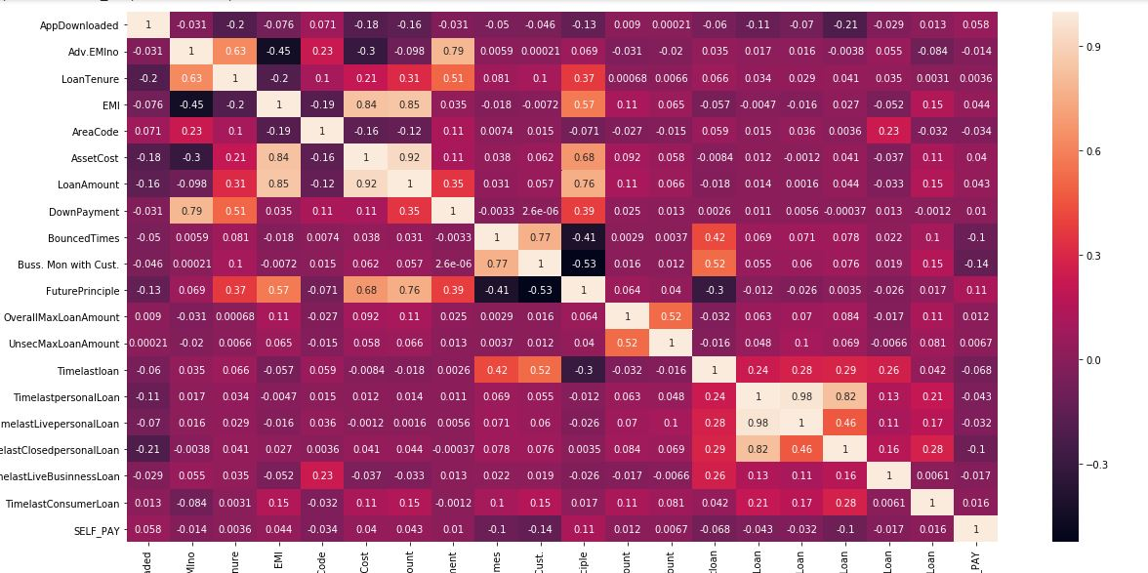
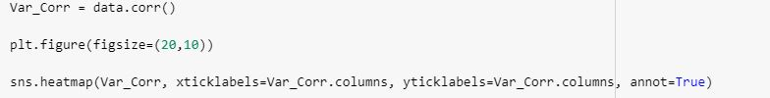
Correlation Heatmap
We plot a correlation map to identify
highly correlated variables, which can
then be removed.
The highly correlated values can be
removed manually or we can use a
technique called Principal Component
Analysis which takes care of high
correlation.

Slide 8
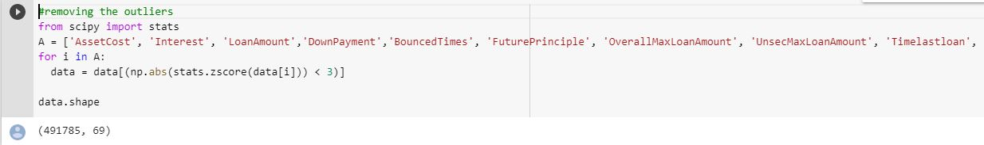
Removing outliers

Slide 9
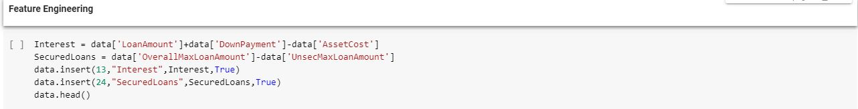
Feature Engineering
We feature engineer two new variables namely Interest and SecuredLoans.
Interest = LoanAmount + DownPayment – AssetCost
SecuredLoans = OverallMaxLoanAmount – UnsecMaxLoanAmount
These new variables help unearth new dependencies of the features to the dataset.

Slide 10
Feature Engineering
The birth date can be converted to a numerical value of AGE which is further for analysis instead
using it in the raw date time format.

Slide 11
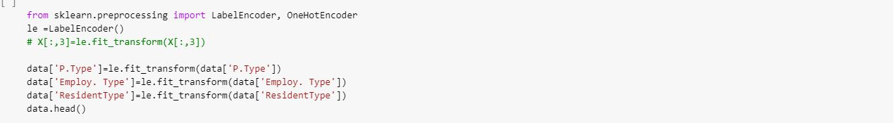
One-Hot and Label Encoding
Categorical variables are first converted by label encoding then into one-hot ,as one hot encoding only takes numerical values.
For AppDownloaded , Yes is assigned with higher value 1 and No with 0 ,as it can be inferred from the dataset that people
with apps tend to selfpay.
Qualification is label encoded according to ratio of self paid divided by self unpaid people.
One-hot encoding for dealer code creates about 8000 columns as , so other pre-processing methods should be preferred

Slide 12
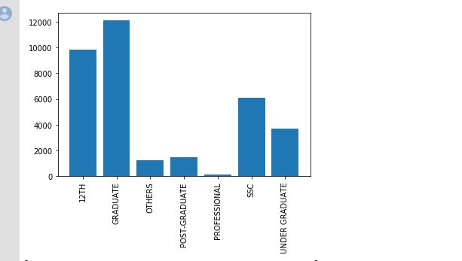
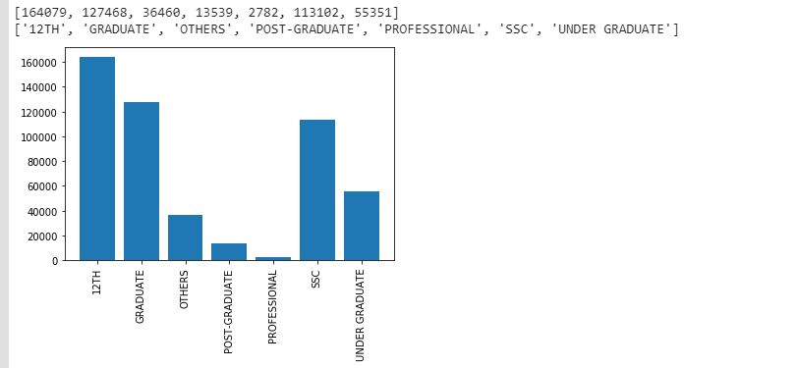
One-Hot and Label Encoding
Qualification plotted against SelfPay = 1 & SelfPay = 0

Slide 13
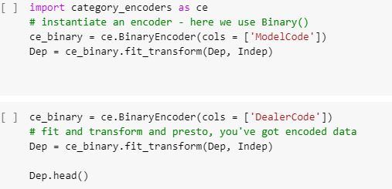
Binary Encoding
Model code have 5385 unique values and dealer code have close to 11221 unique values. So, we will use
binary encoding for this.

Slide 14
Data Split and Scaling
The training and test set are split in the ratio of 4:1, in order to train the models and verify it using the
various classification algorithms.
First before fitting the model we scale the data to maintain uniformity amongst features.

Slide 15
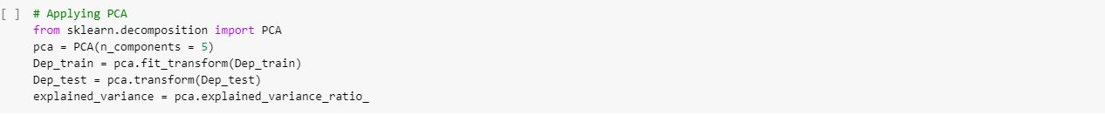
Principal Component Analysis
Principal component analysis (PCA) is a statistical procedure that uses an orthogonal transformation to convert a set of observations of possibly correlated variables (entities each of which takes on various numerical values) into a set of values of linearly uncorrelated variables called principal components.
For this particular dataset , we extract the features into 5 distinct principal components.

Slide 16
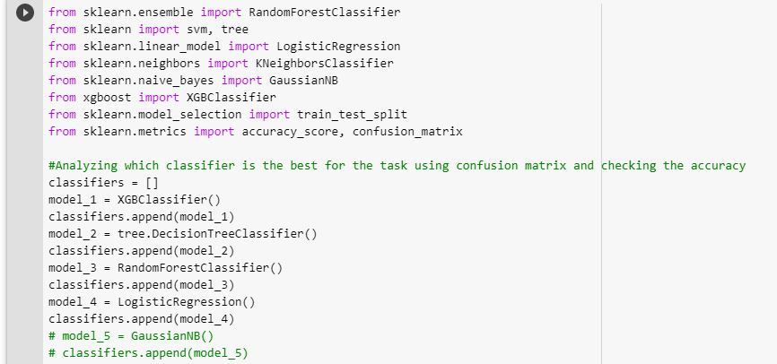
Training Models
We use the dataset to train models of
XGB Classifier,
Decision trees,
Random forest,
Logistic Regression,

Slide 17
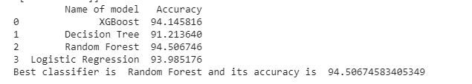
Accuracy
We observe that Random Forest produces the highest accuracy rate.
We further use it trained model to predict
values of new datasets in the feature.

Slide 18
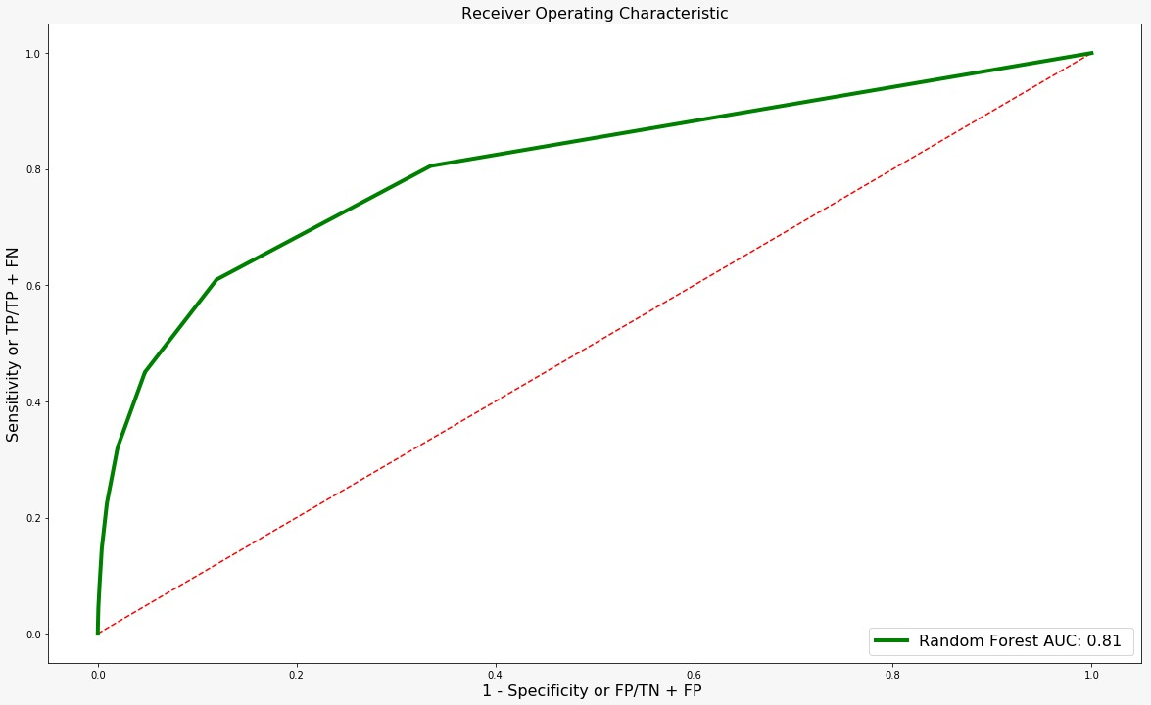


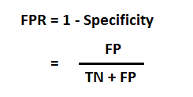
ROC Curve

Slide 19
Conclusion
The data has been analysed and machine learning techniques have been applied to train an appropriate model which can be deployed in TVSCredit’s system to improve efficiency and in turn increase profits.
The model for 94.5% of the time correctly classifies the defaulters.

Slide 20

Thank You

